Slide 1
INITIAL THERMAL EVALUATION OF 422 MARTENSITIC STAINLESS STEEL PISTON IN A HIGH-OUTPUT DIESEL ENGINE
Eric Gingrich¹, PhD¹, Michael Tess, PhD¹, Arkady Grunin¹, Vamshi Korivi, PhD¹, Katherine Sebeck, PhD¹, Dean Pierce, PhD ², Yiyu Wang, PhD ², Govindarajan Muralidharan, PhD ², Rishi Pillai PhD ², James A. Haynes, PhD ², Kurt Will ³
¹US Army DEVCOM GVSC
²Oak Ridge National Laboratory
³Tenneco Powertrain
DISTRIBUTION STATEMENT A. Approved for public release; distribution is unlimited. OPSEC#10903

Slide 2
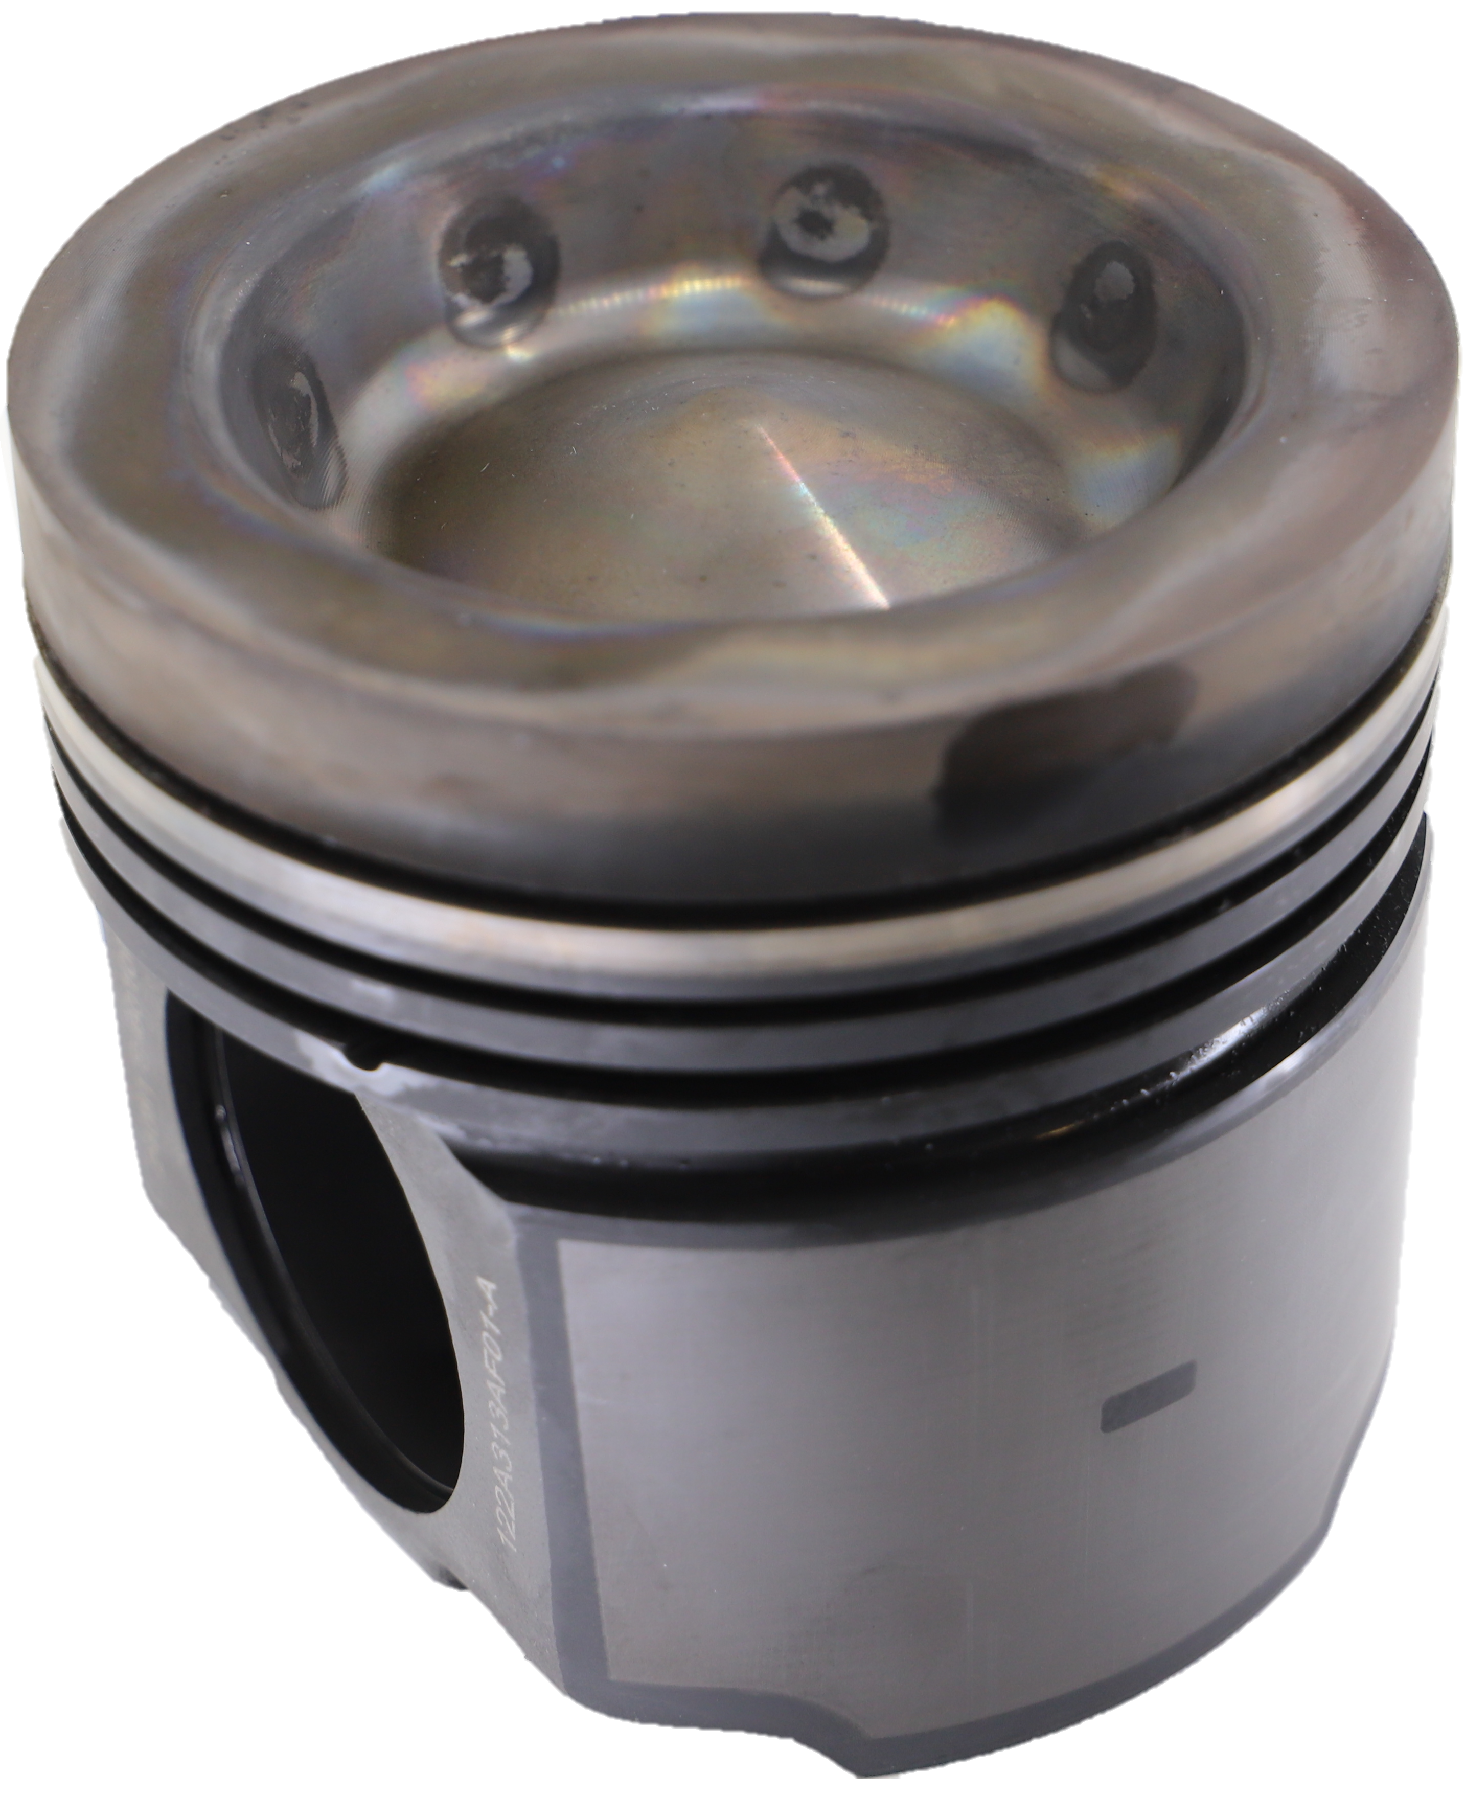
Bottom Line Up Front
When alloy 422 is used as a piston crown material, it is poised to offer a dual durability advantage because it can achieve superior oxidation resistance without operating at the higher temperatures that would accelerate such degradation. Additional testing at extreme piston temperature conditions and longer operating time is needed to assess the potential benefits of alloy 422.

Slide 3
OUTLINE
Background and Motivation
    Experimental Setup
    Simulated Piston Temperature
    Measured Piston Temperature
    Discussion on Piston Temperature Trends
    Piston Visual Inspection
Summary and Conclusions
Paper Only Topics (not discussed today)
Sensitivity studies of piston temperature (Oil temperature, IMT, PCN flow, CA50)
Thermocouple Uncertainty/repeatability
Additional engine load/speed conditions

Slide 4
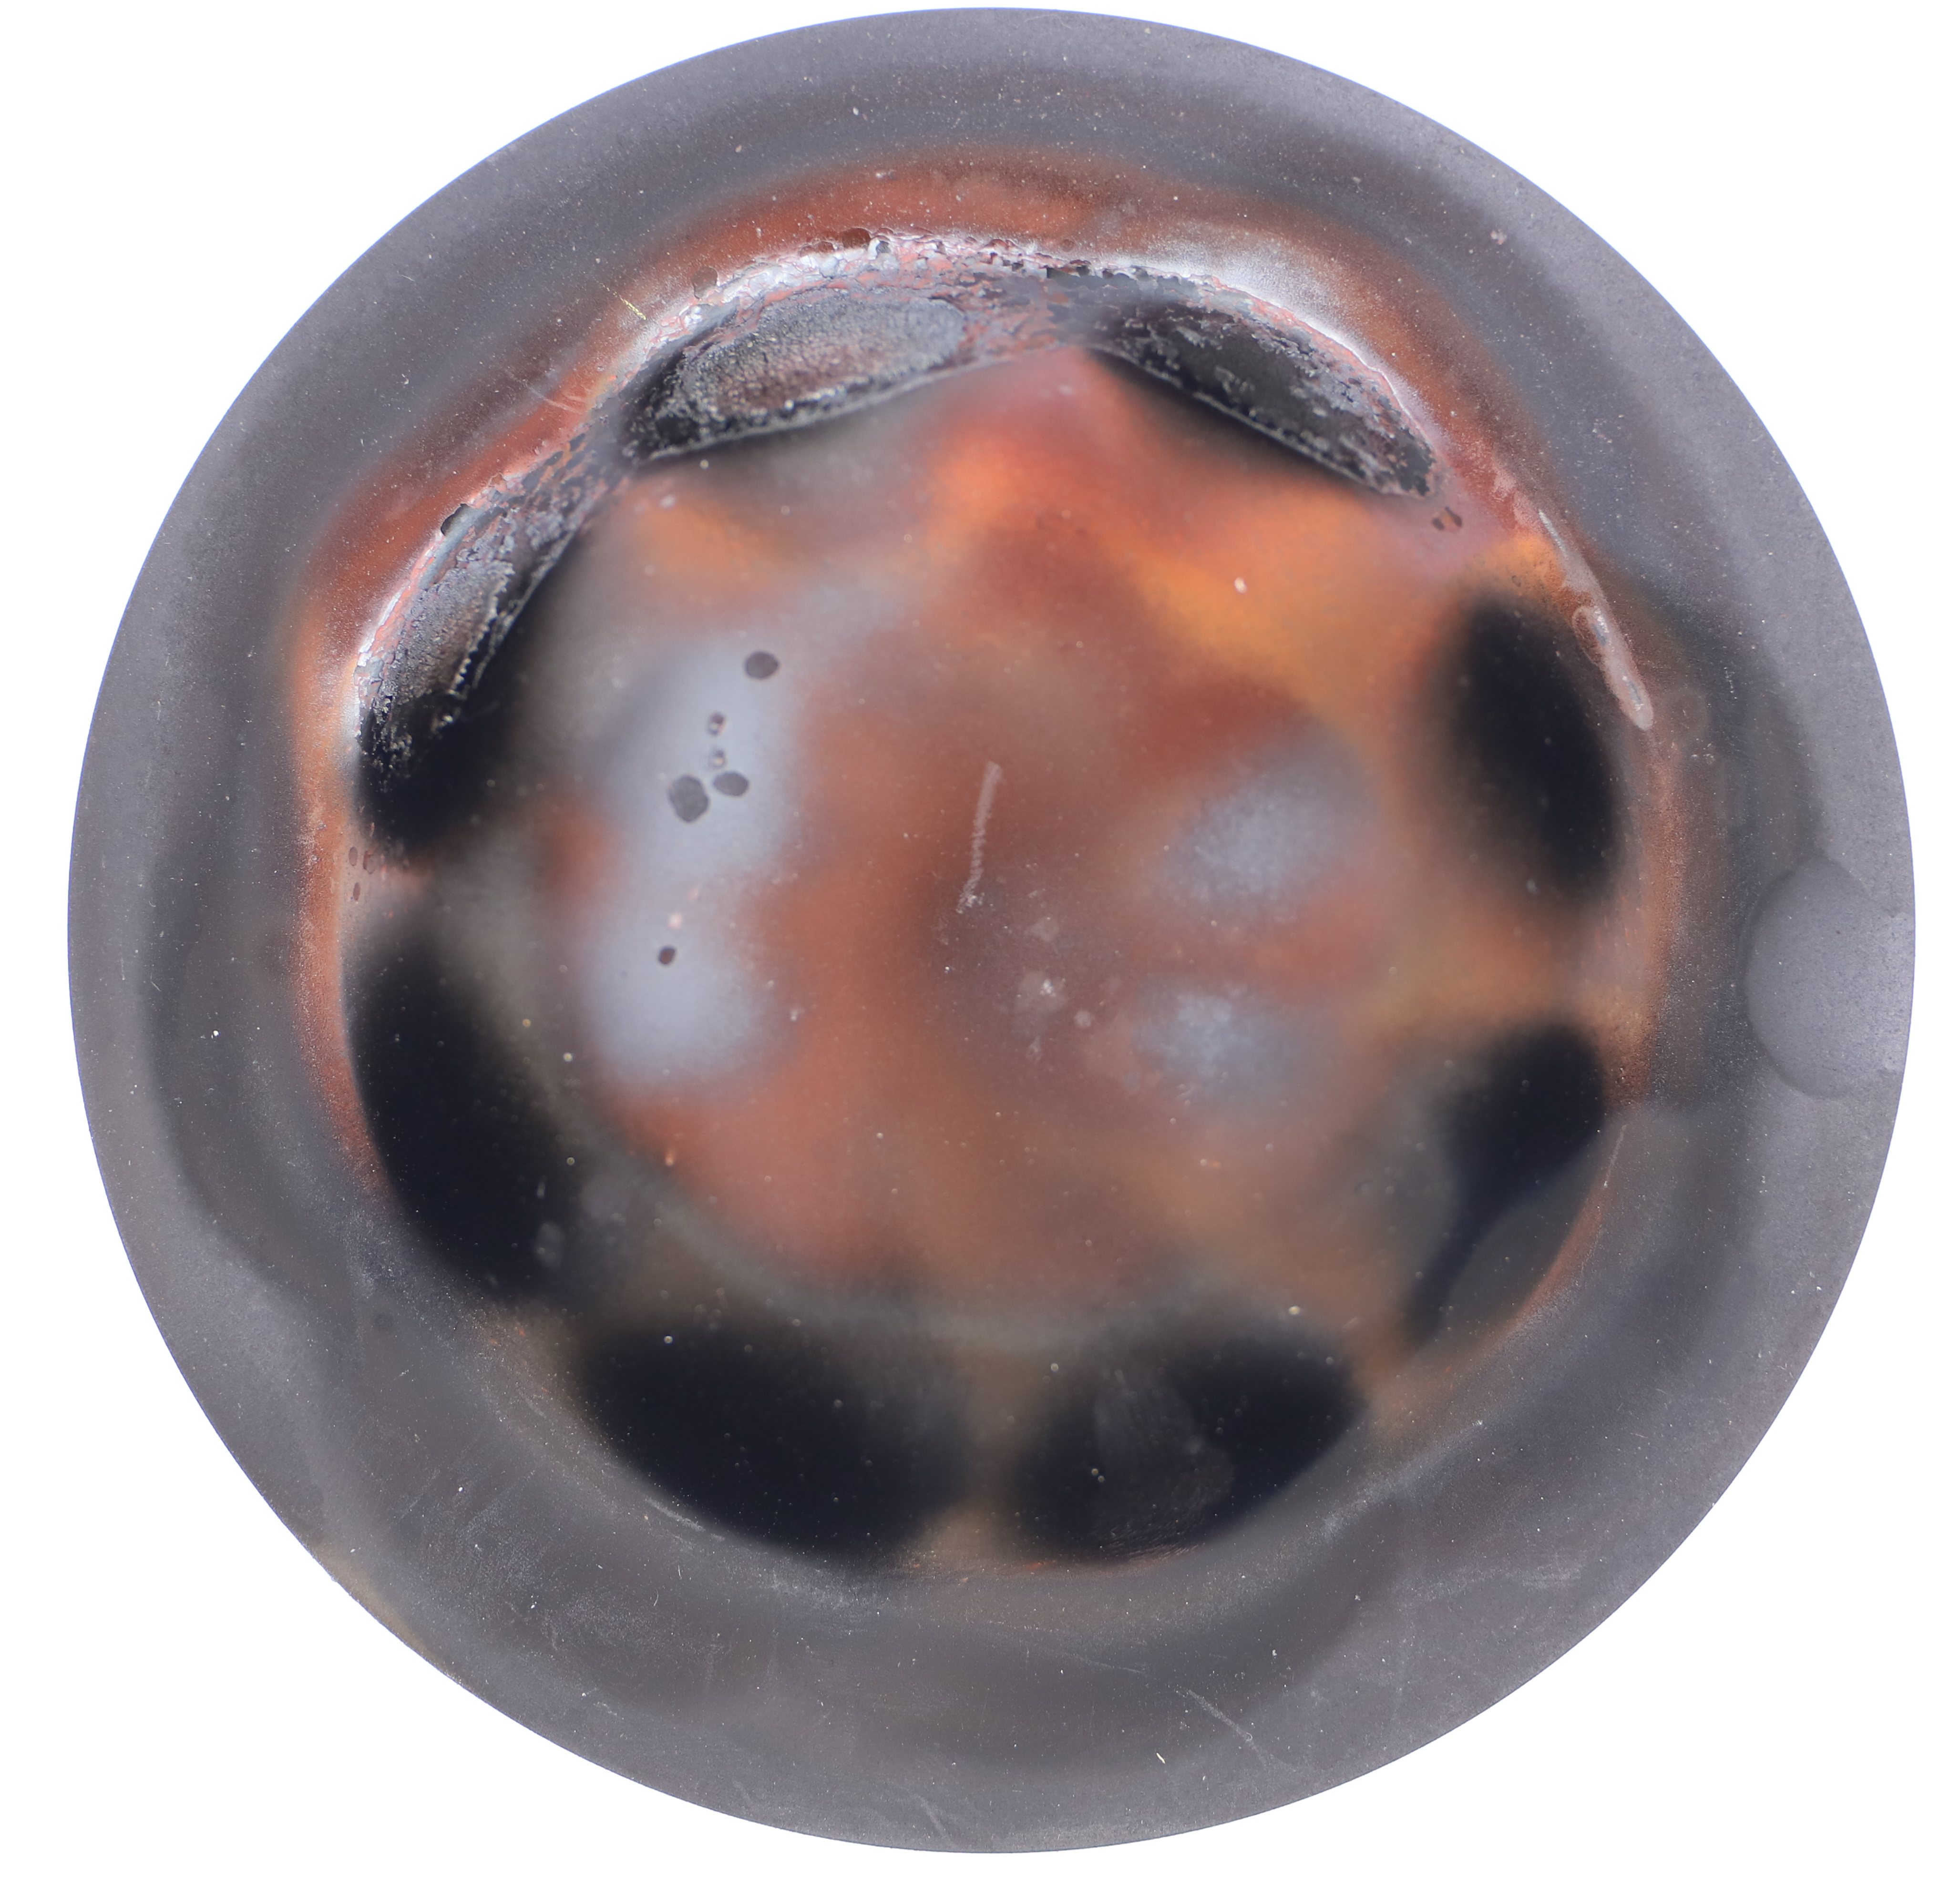
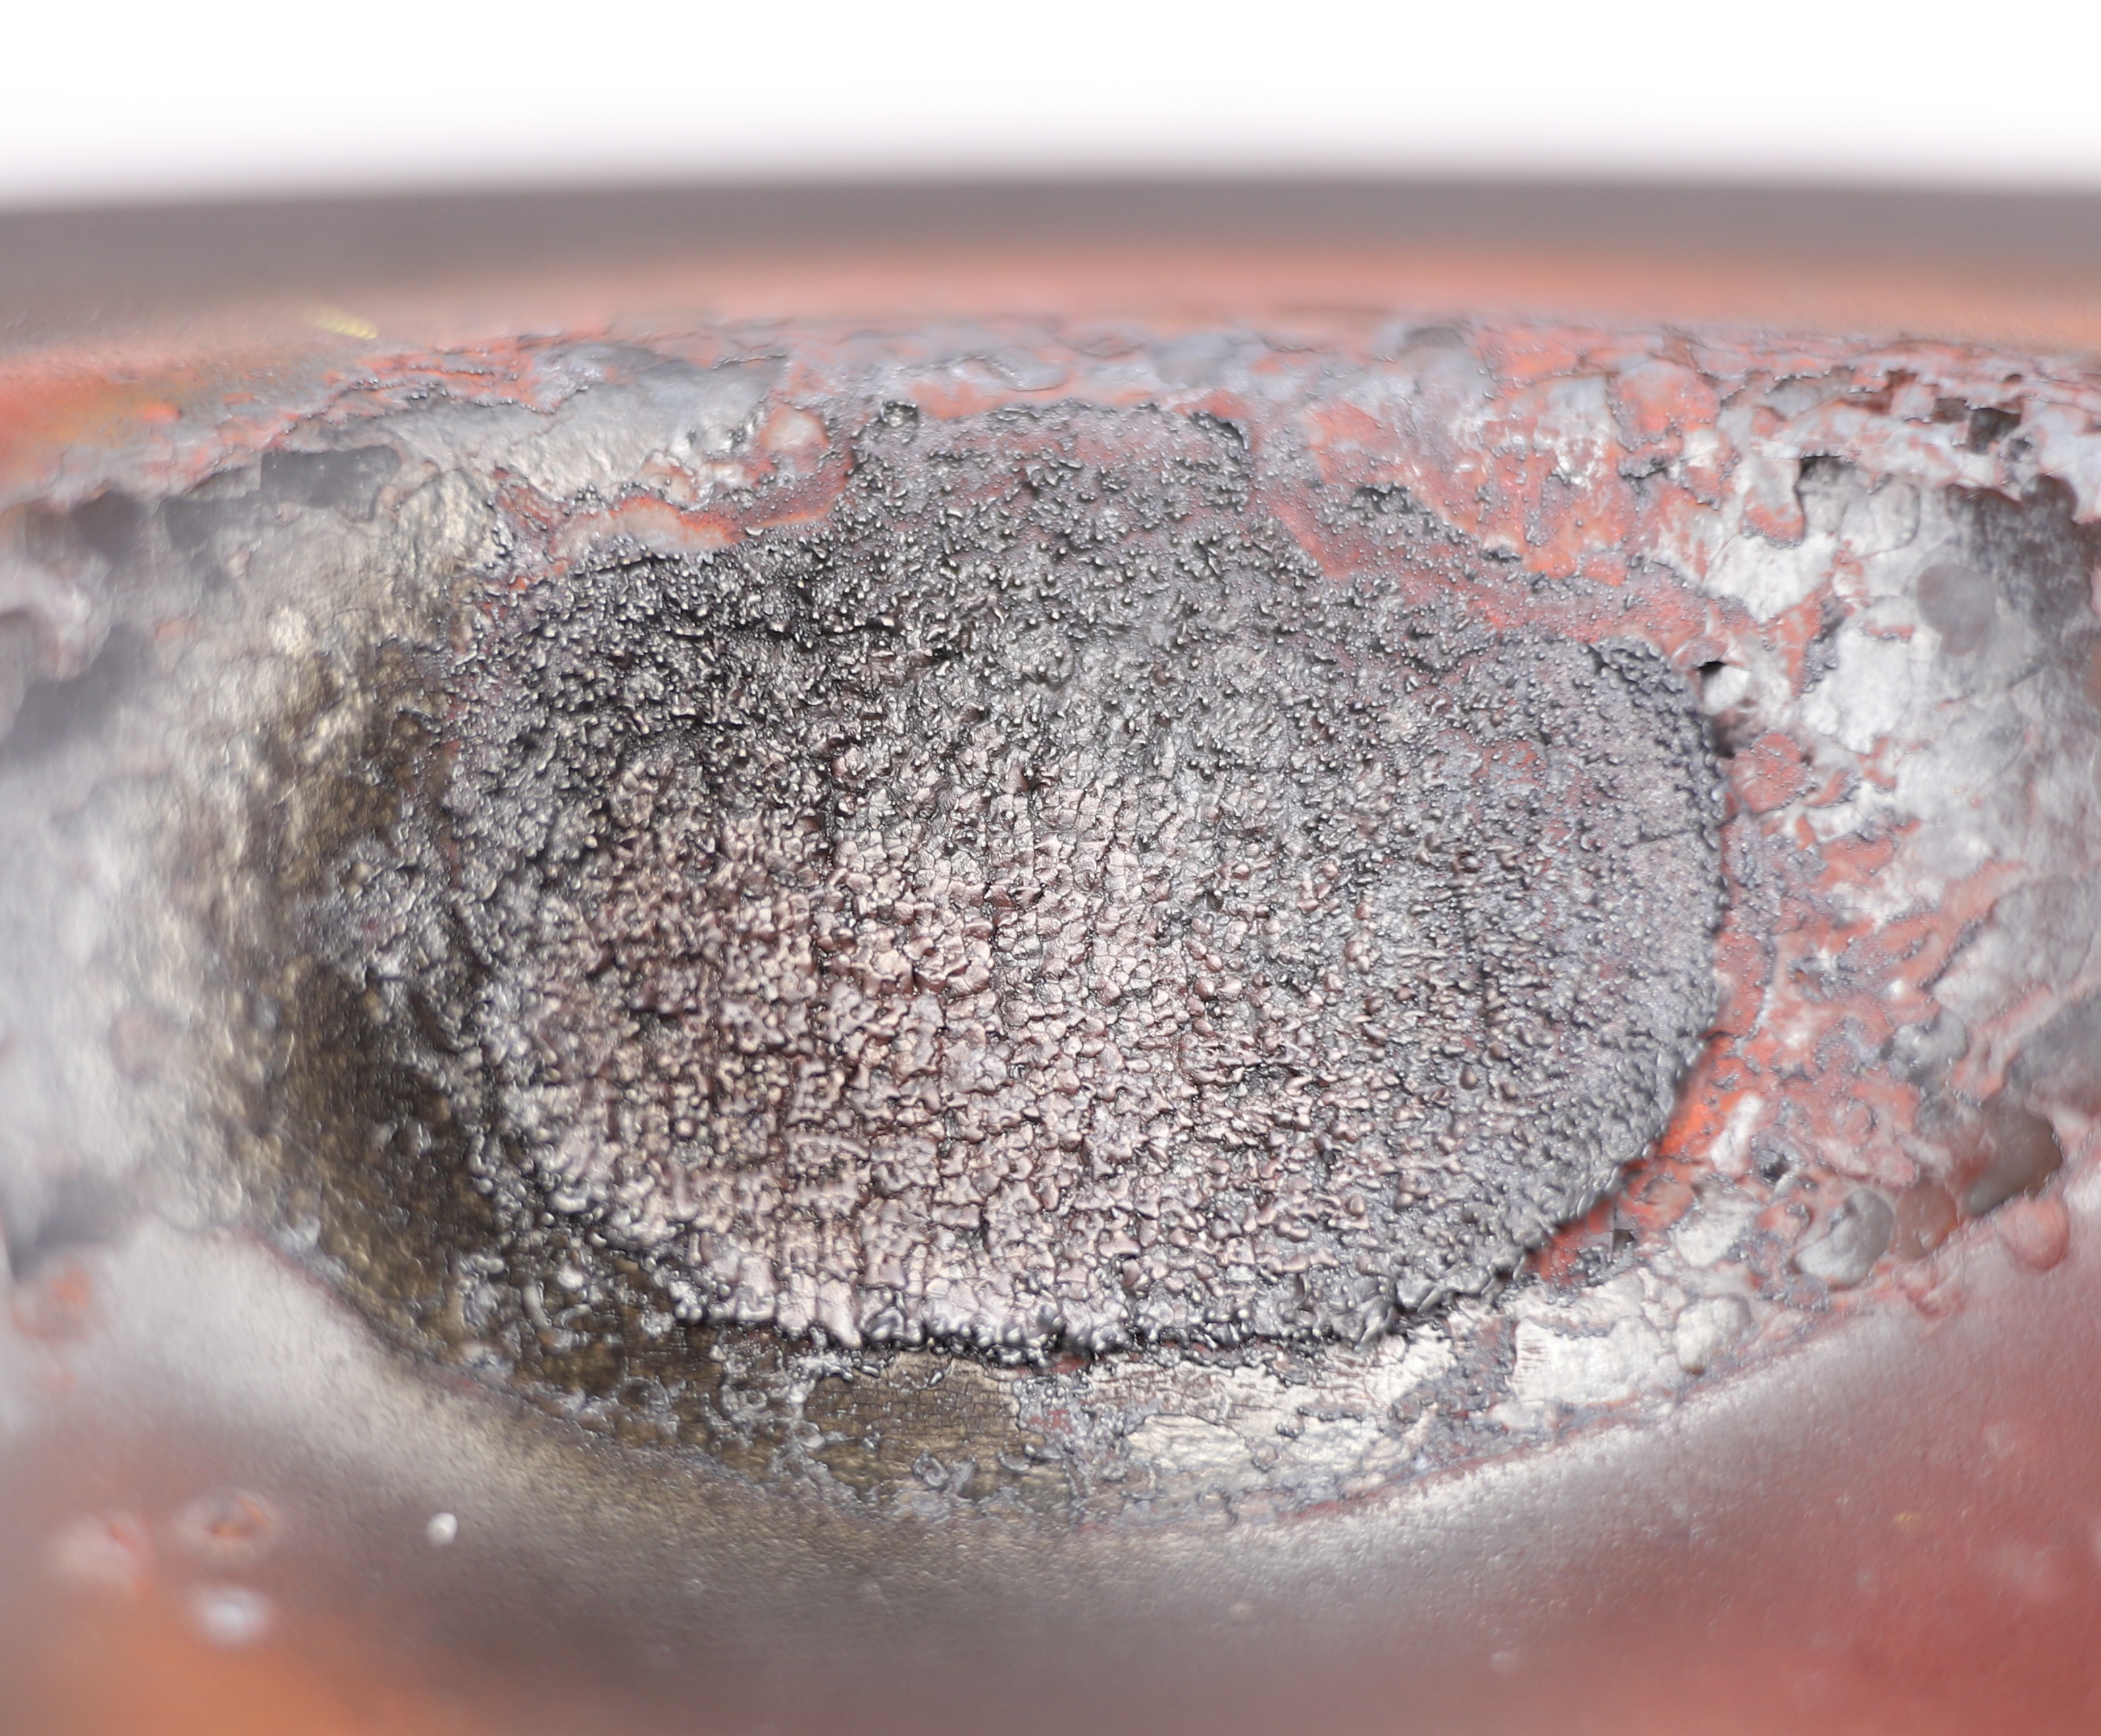
Background and Motivation
Advances in both military and commercial diesel engines have resulted in trends toward higher cylinder pressures and temperatures, which are constrained by the strength and temperature limits of the piston material
Piston materials require a good balance of elevated temperature strength, oxidation resistance, and suitable thermal properties
Steel alloys currently used for heavy-duty diesel engine pistons include 4140 and microalloyed steel (MAS)
    Deleterious effects of high-temperature oxidation impose an operating temperature limit of 500 to 550 °C for traditional piston alloys
Transition Objective: Develop a materials solution for increasing the continuous operating pressures and temperatures of pistons for heavy-duty diesel engines
Under Crown
Pierce et al., Materials & Design, 2022

Slide 5
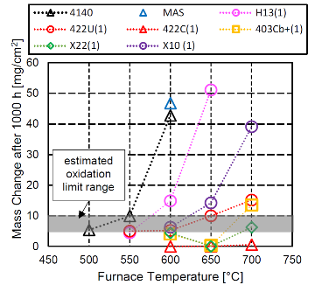
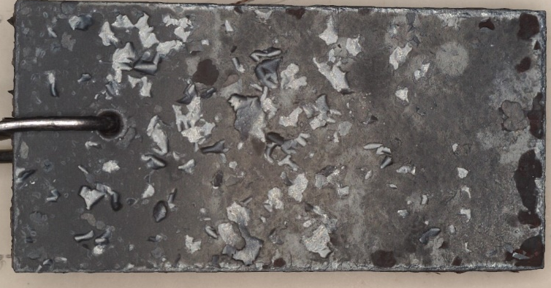
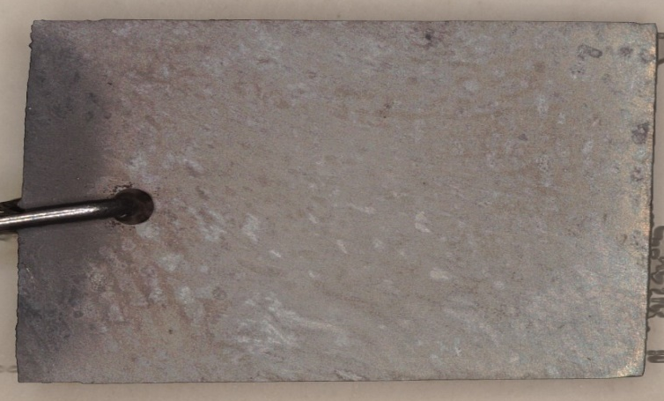
Background – Why Alloy 422?
Decrease in Conductivity
Gingrich et al., SAE 2022-01-0599
422 shows no oxidation up to 700°C
Gingrich et al., SAE 2022-01-0599
Gingrich et al., SAE 2022-01-0599
MAS
Chemical compositions in wt.%
Element | Ni | Mn | C | Cr | Si | V | Mo | Cu | W | S | P | Nb | Fe
MAS | 0.04 | 1.4 | 0.41 | 0.15 | 0.52 | 0.09 | 0.036 | 0.082 | - | 0.045 | 0.013 | <0.002 | Bal.
4140 | 0.21 | 0.88 | 0.41 | 0.99 | 0.26 | 0.001 | 0.21 | 0.17 | - | 0.012 | 0.009 | - | Bal.
422 | 0.79 | 0.78 | 0.23 | 12.1 | 0.36 | 0.22 | 1.08 | 0.08 | 0.96 | 0.006 | 0.019 | 0.026 | Bal.
422

Slide 6
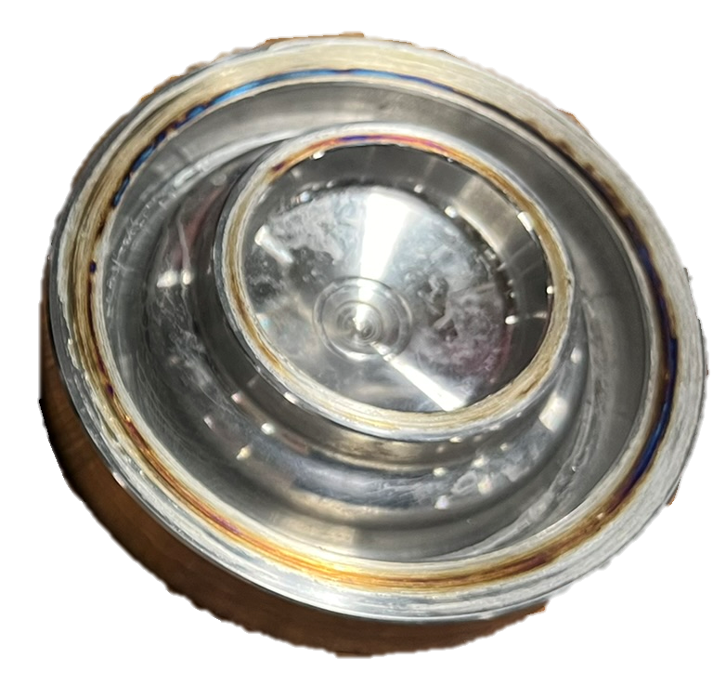
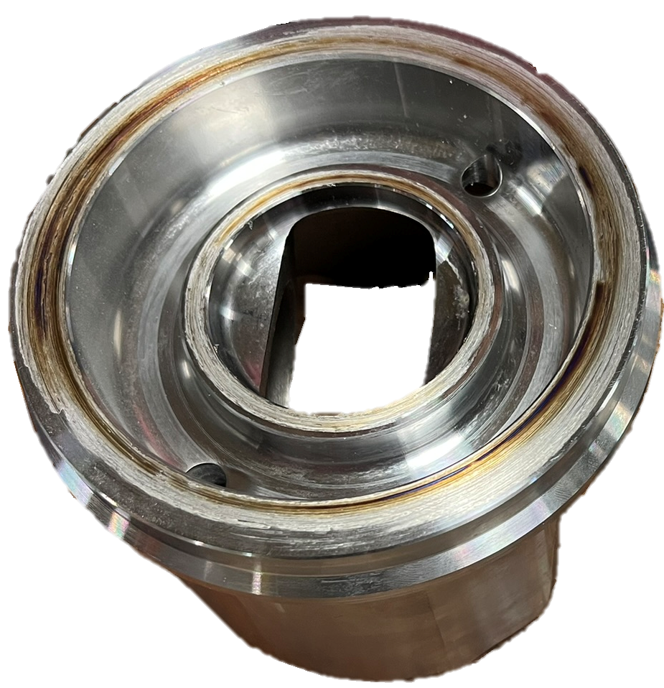
Piston Description
The piston application is a high-output, single-cylinder research engine
Solid state, rotary inertia friction weld (RIFW) process
Traditional steel piston alloys:
  Medium-carbon microalloyed steel, 38MnSiVS5
  Quenched and tempered 4140 martensitic steel
Innovation in this work: Multi-material steel piston
  Crown material:
    422 martensitic stainless steel
    Machined billet
  Bottom forging (skirt & pin boss) material
    4140 martensitic steel
    Forged
Piston Architecture | One-piece steel weldment made by joining a crown to a skirt
Piston Cooling | Enclosed gallery, single oil cooling nozzle
Bore Diameter | 122 mm
Pin Diameter | 54 mm
Compression Ratio | 14.0
Ring Pack | 2 compression + 1 oil control
Peak Firing Pressure | 250 bar
Nominal oil flow rate | ≥ 6 L/kW-h
Weld interfaces

Slide 7
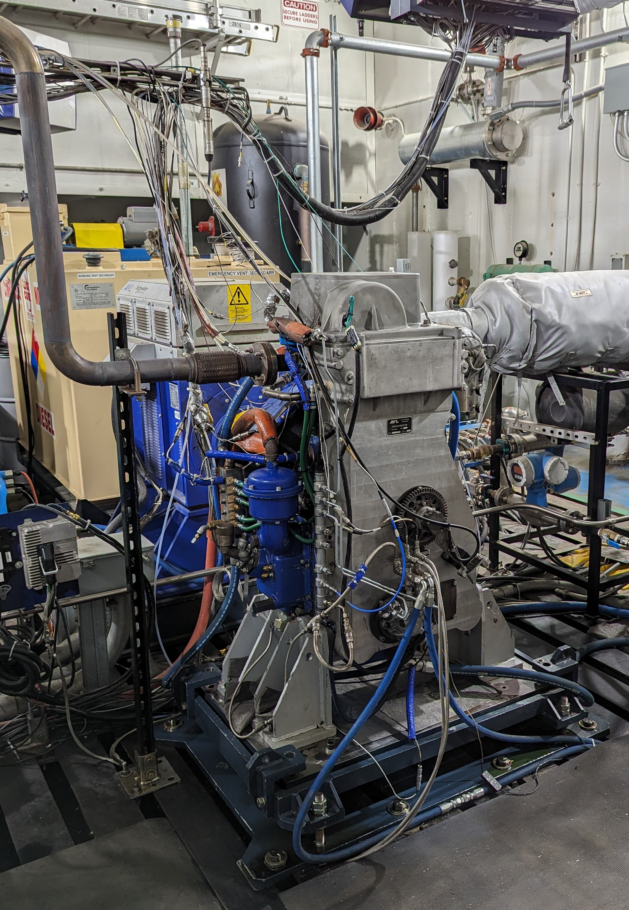
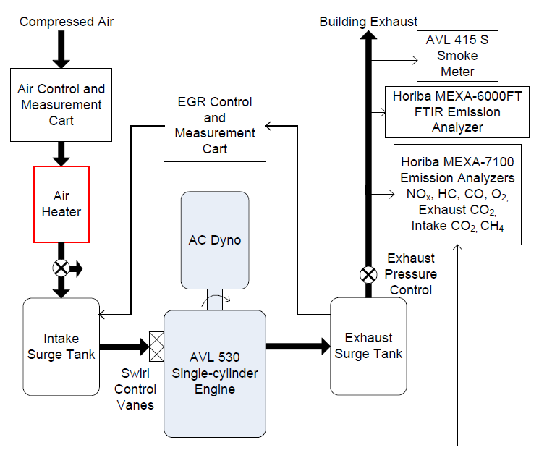
Experimental setup – Single-cylinder Engine
Displacement (L) | 1.49
Bore (mm) | 122
Stroke (mm) | 128
Number of Valves (-) | 4
Compression Ratio (-) | 14.0
Swirl Ratio | 0-3.5 (variable)
Peak Firing Pressure (bar) | 250
Max. Injection Pressure (bar) | 2000
Injector Nozzle Geometry (mm) | 8 × 0.167
High-output single cylinder research engine
Piston instrumented with embedded thermocouples (1mm subsurface) and a wireless telemetry system

Slide 8
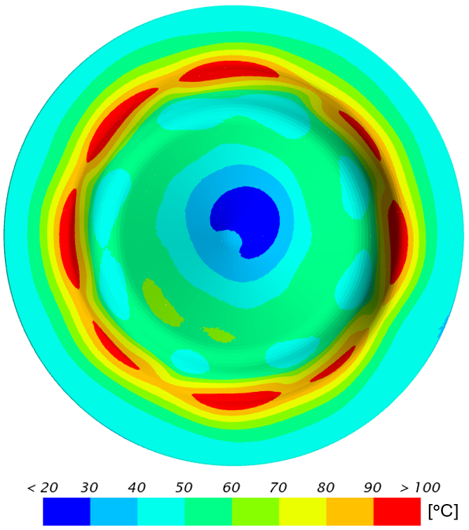
422 Expected Temperature – Steady State Conduction Model
Decrease in Conductivity
Increase in 422 Temperature
Temperature difference between 422 and 4140, Operating Condition 5 (2750rpm, 27.4 bar IMEPg)

Slide 9
Piston Temperature
Condition 1 (1700rpm, 11.2 bar IMEPg)
Condition 3 (1700rpm, 19.3 bar IMEPg)
Stainless steel alloy 422 does not show a significant increase in temperature despite have a much lower thermal conductivity.

Slide 10
Average Piston Temperature
Condition | Speed (r/min) | IMEPg (bar) | AFR (–)
1 | 1700 | 11.23 | 30
2 | 1500 | 22.1 | 24
3 | 2500 | 19.3 | 26.9
4 | 1700 | 27.4 | 25
5 | 2750 | 27.4 | 26.6
4140 average piston temperature 10-25°C higher than 422 (OC 2-5)

Slide 11
Discussion on Piston Temperature
Why does 422 show a similar temperature (sometimes a decrease) despite a decrease in thermal conductivity of 422 relative to 4140?
Changes in oil gallery geometry
Thermocouples sub-surface 1.0±0.5 mm →
±7.5-20 °C
Efficiency and Specific Heat rejection similar for 4140 and 422

Slide 12
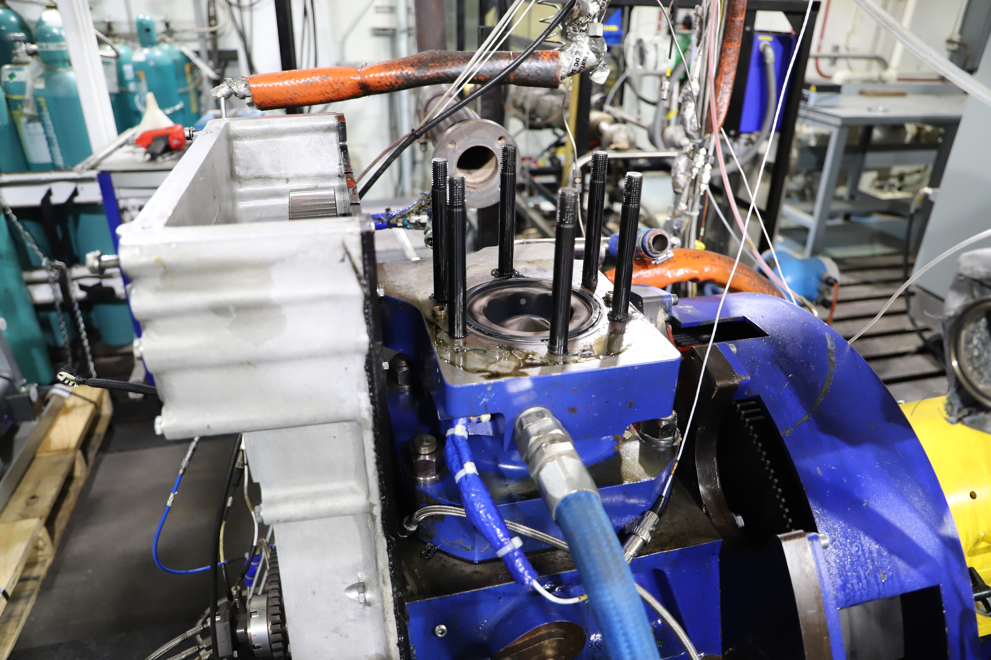
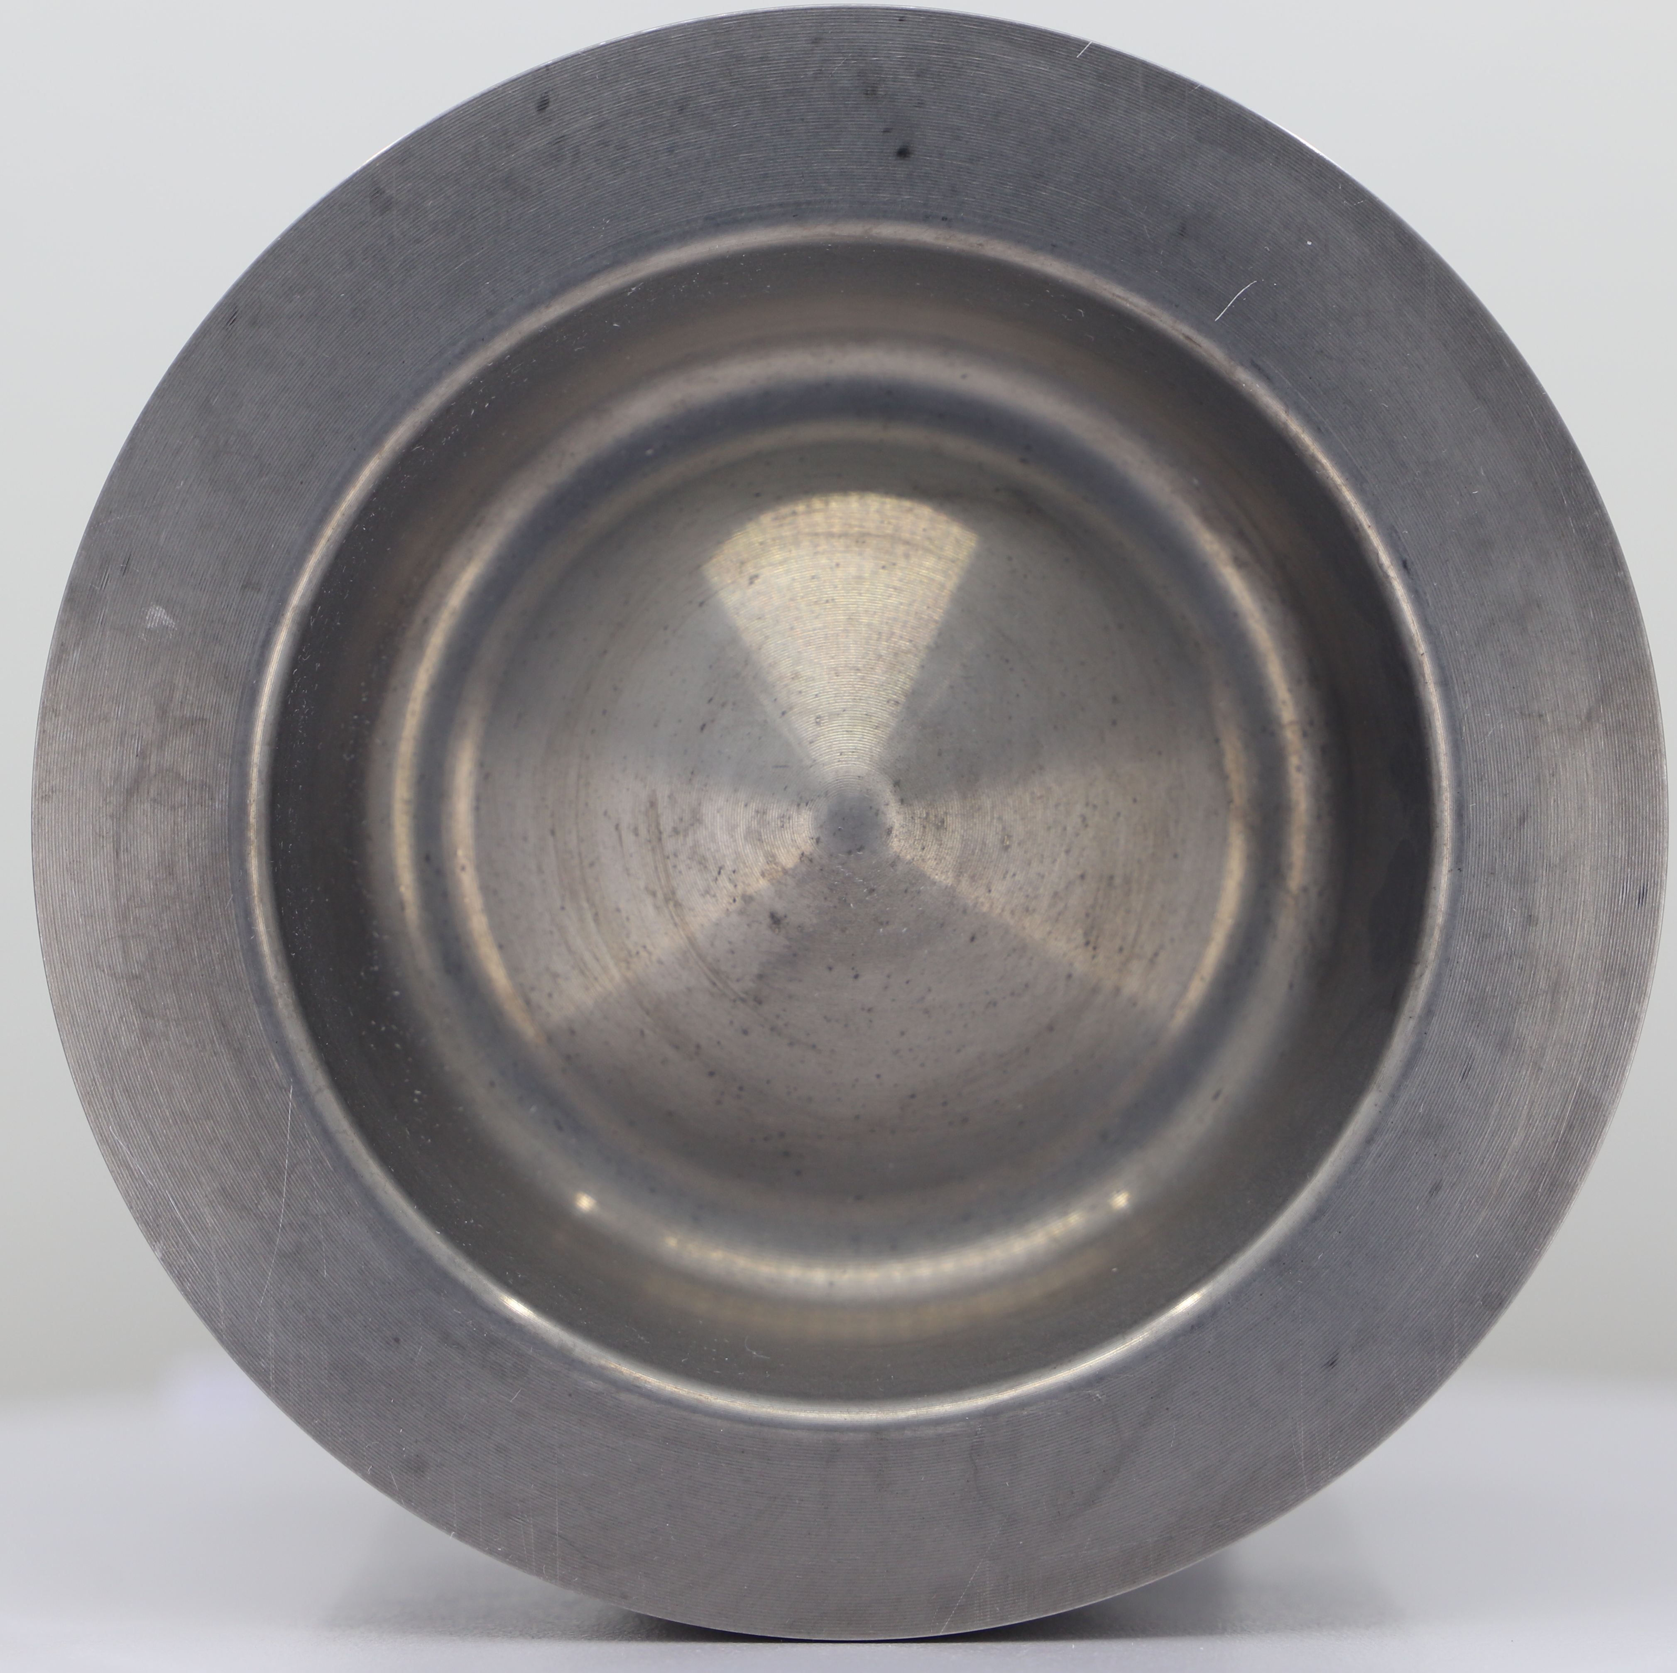
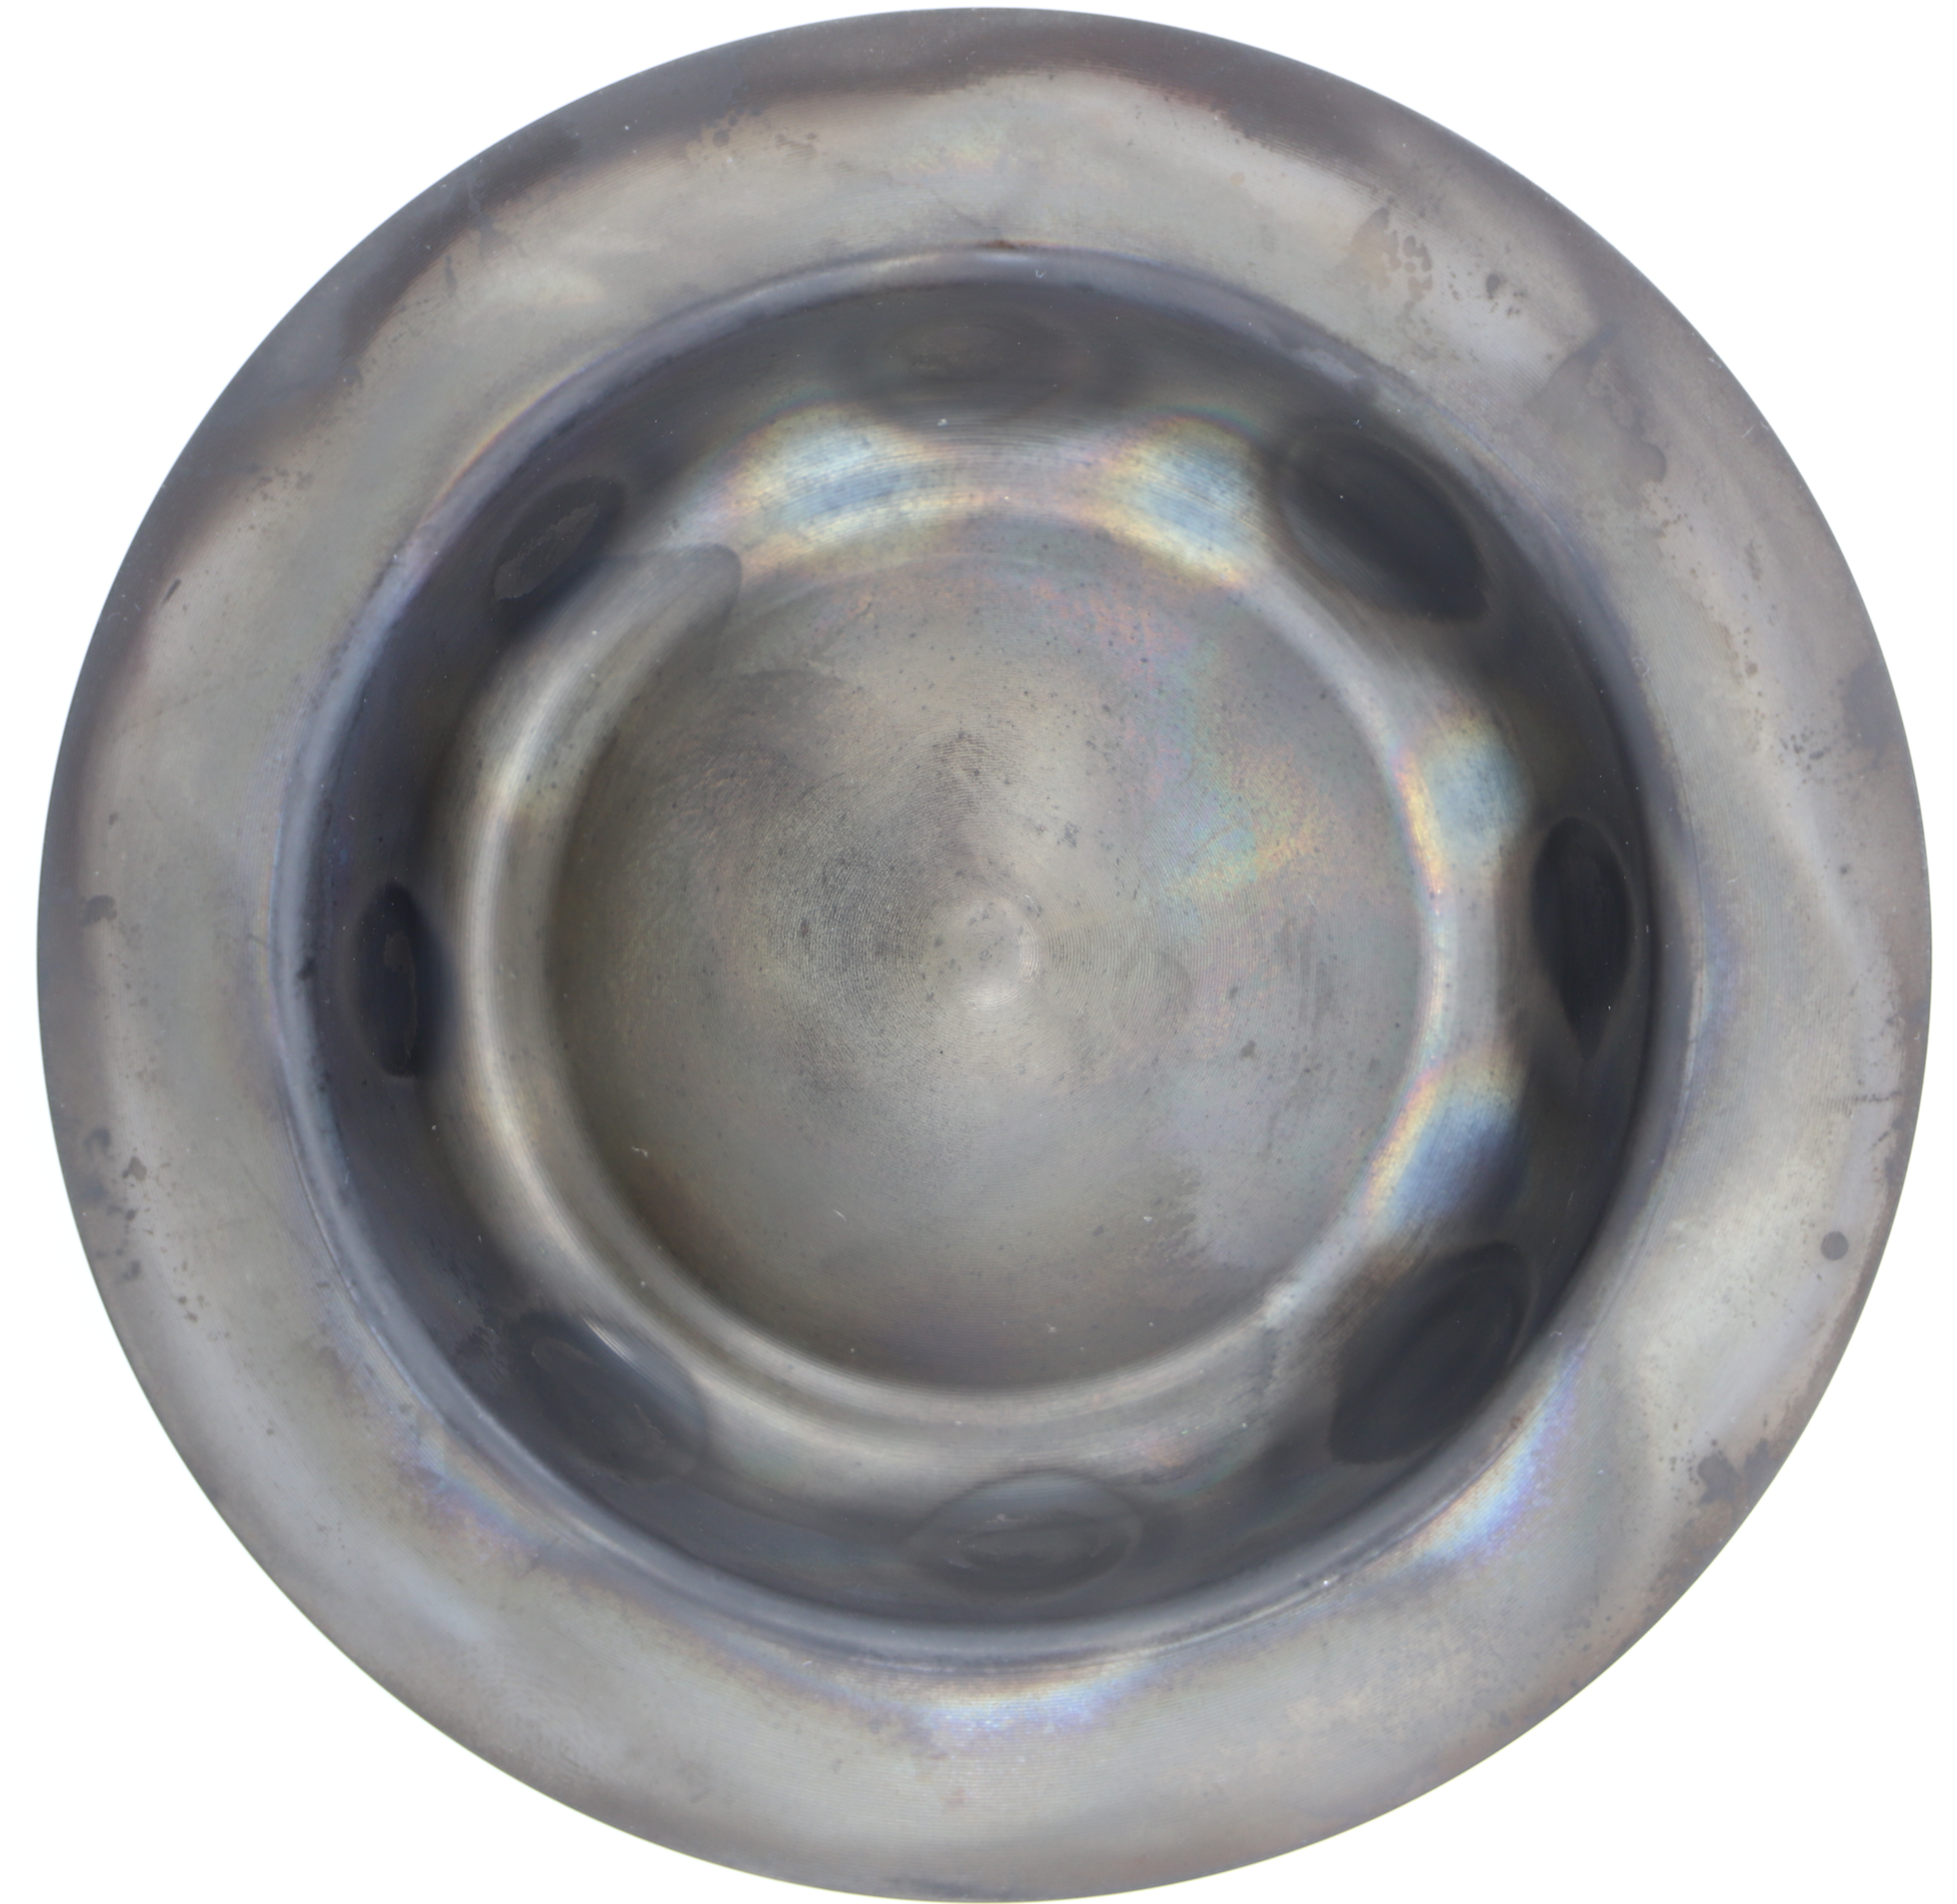
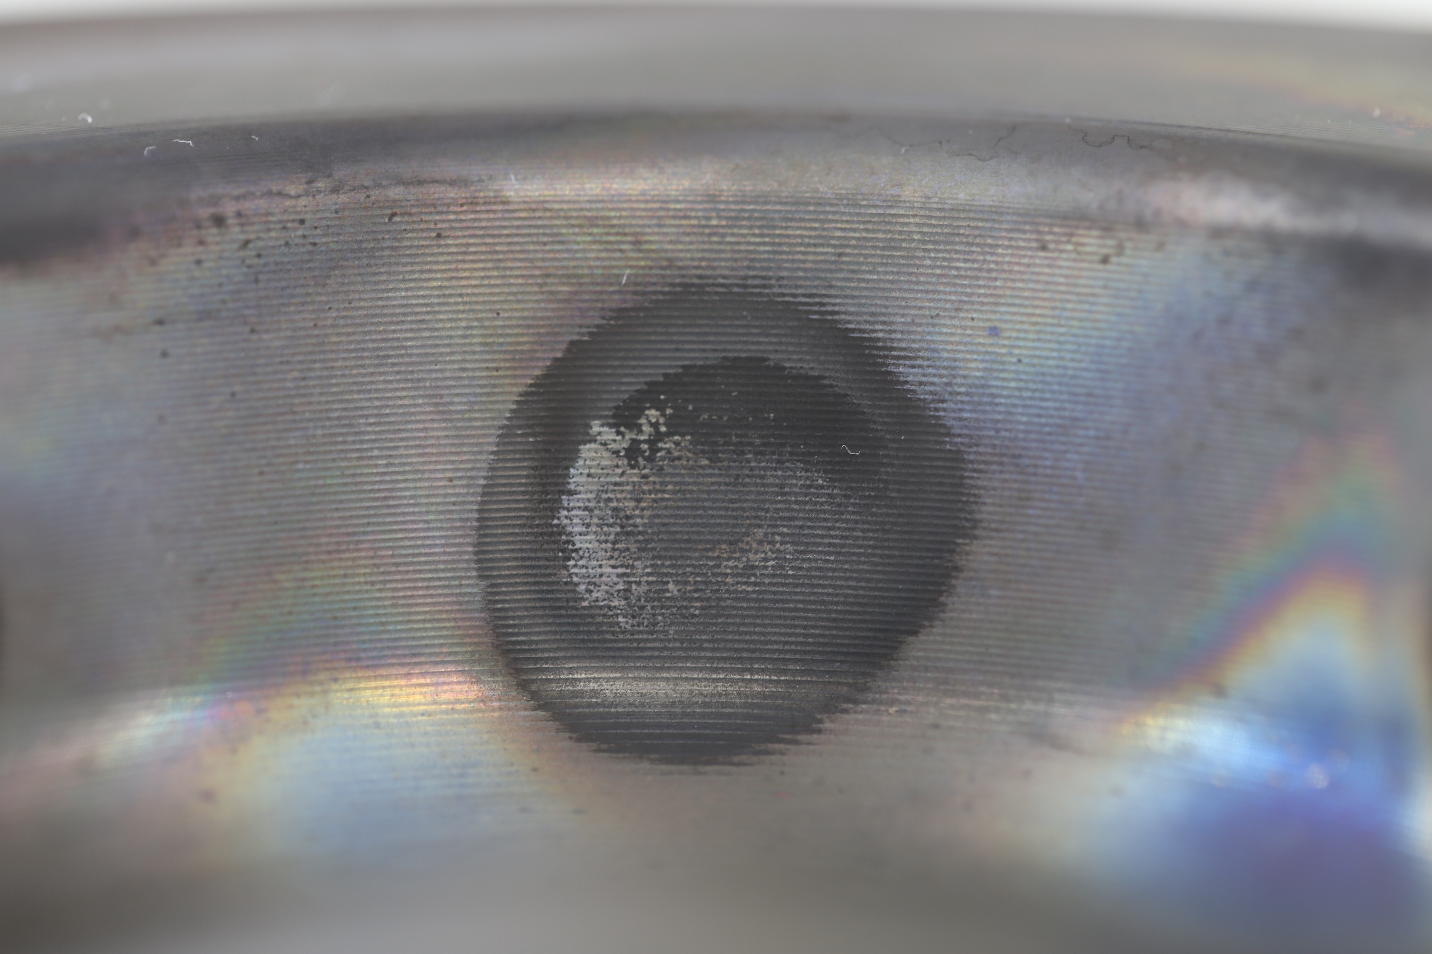
Visual Inspection
New
Post-test (~50hr)
No visible oxidation
Rainbow color may indicate protective chromium oxide layer
No visible weld quality issues

Slide 13
Summary and conclusions
Contrary to initial expectations, 422 alloy resulted in no statistically significant change in piston temperatures relative to the baseline 4140 steel during engine testing. This result was initially regarded as counterintuitive, as the predicted temperatures of 422 were up to 104 °C hotter, driven by thermal conductivity of the 422 which is approximately 25% lower than that of 4140 steel at 550 °C.
Dissimilar 422 alloy steel pistons were successfully tested in a single-cylinder diesel engine for approximately 50 hours.
Open question – Why didn’t 422 piston temperature data show an increase relative to 4140?
Future work:
Conduct single-cylinder engine 50 hour durability test at 600 °C piston temperature and compare oxidation for 4140 and 422 pistons.
Explore the path to higher temperature and pressure operating conditions enabled by 422 alloy

